Slide 1
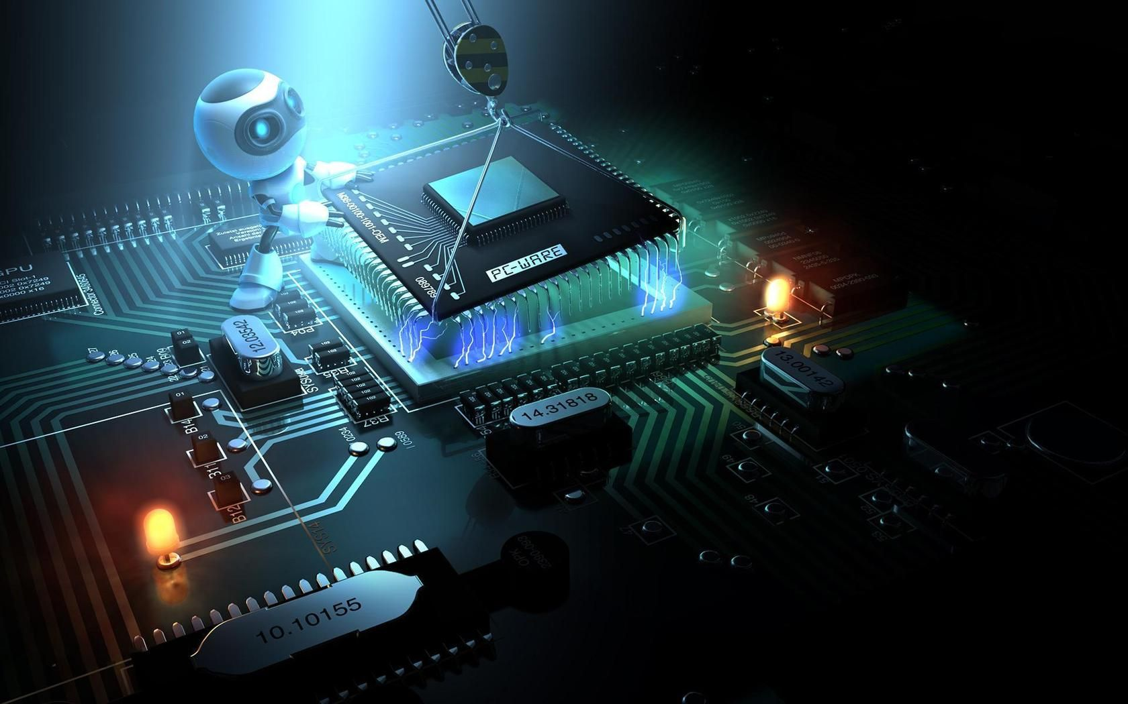
DIY PROJECT
Team :- 01
PROJECT: Fingerprint(Bluetooth) stimulated Lock System
DEVELOPERS: Section 11

Slide 2

Team Members
Anmol Kumar (20HS20010)
Divyanshu Gupta (20BT10016)
Satyanshu Kumar (20GG20040)
Aditya Kumar Singh (20MF10003)

Slide 3

Project Description
This project is a Mobile Bluetooth operated locking/unlocking mechanism. It enhances the safety of our belongings and reduces human effort. We will be using an Arduino Uno Board, a Bluetooth module and some other basic components for this project.
The concept of IOT has been used in this project.

Slide 4

The person who desires to lock/unlock the door uses the application in their Android device, which reads and verifies the fingerprint of the person. If the fingerprint is verified successfully, the servo motor rotates, pulling off the latch and hence, opening the door. After a delay of five seconds, the servo motor returns into the normal position, hence closing the latch. This contact-less functioning of the door enhances the safety as only authorized people can open or close the door. Another significant point is that this reduces physical contact.

Slide 5

Components Used
Arduino UNO Board
Bluetooth Module
Micro Servo
Door Lock (LATCH)
Jumper wires

Slide 6

Expenses & Contribution
Arduino Uno : Rs. 750/-
Servo Motor : Rs. 194/-
Bluetooth Module : Rs. 385/-
Rs. 332.25/- was Contributed by per head

Slide 7

Advantages
Disadvantages
Door auto locks after 5 sec (for Demonstration purpose only, can be reset).
APP dependent, so keep it Handy.
If the power supply lost, it can’t be functionable.
Reduces Human efforts
Easy to handle
Cheaper
Less Maintenance Cost

Slide 8

Individual Contribution
Aditya :- Written the code for Arduino UNO
Anmol :- Assembly of the components
Satyanshu :- Developed the Android app. + Prepared the slides
Divyanshu :- Gave Hardware Implementation Ideas + Video Editing + Helped in Arduino code + Made Report

Slide 9

Procedure followed
We first formulated our basic design and then created the circuit.
We used Arduino IDE to test and run our code.
Using the drag-n-drop mechanism on Kodular Creator, we created our Android app for the Bluetooth lock.
Finally, we assembled the various components together and test ran our code successfully.

Slide 10

Work Report
Week 1 :- Researched & discussed on the project. Ordered all the components required.
Week 2 :- Started working on the Arduino code and App development. The components were yet to arrive.
Week 3 :- We set up the components once they arrived and tested our Arduino code and the app.

Slide 11
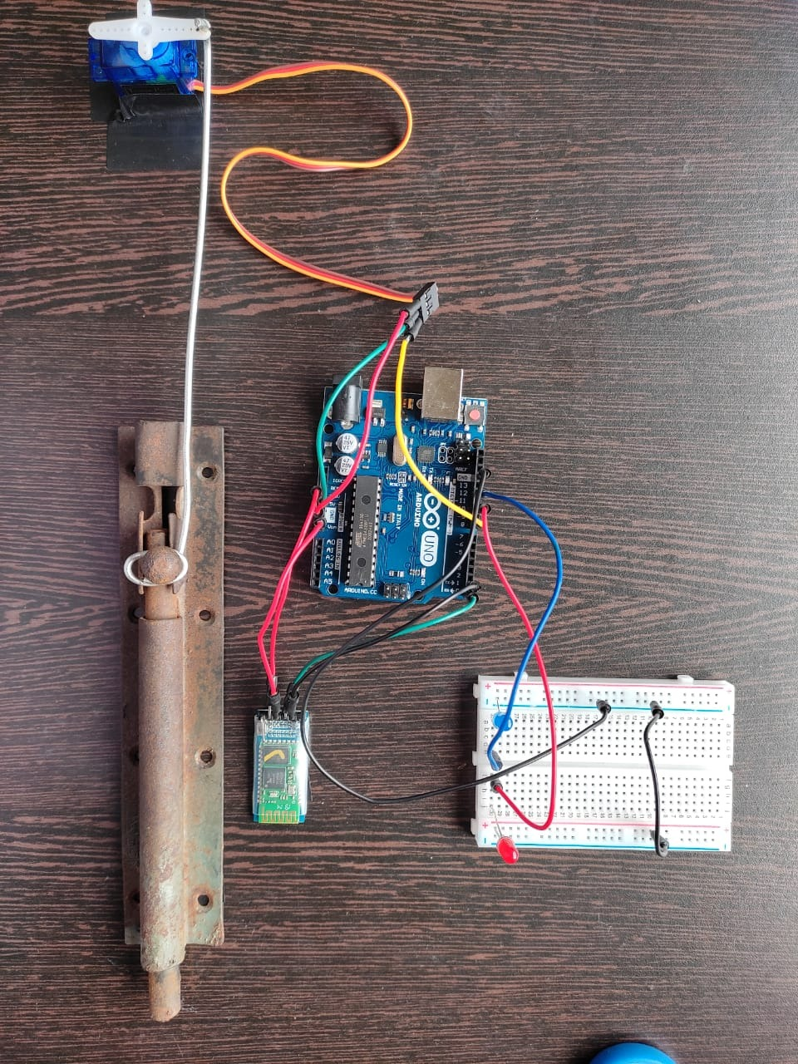
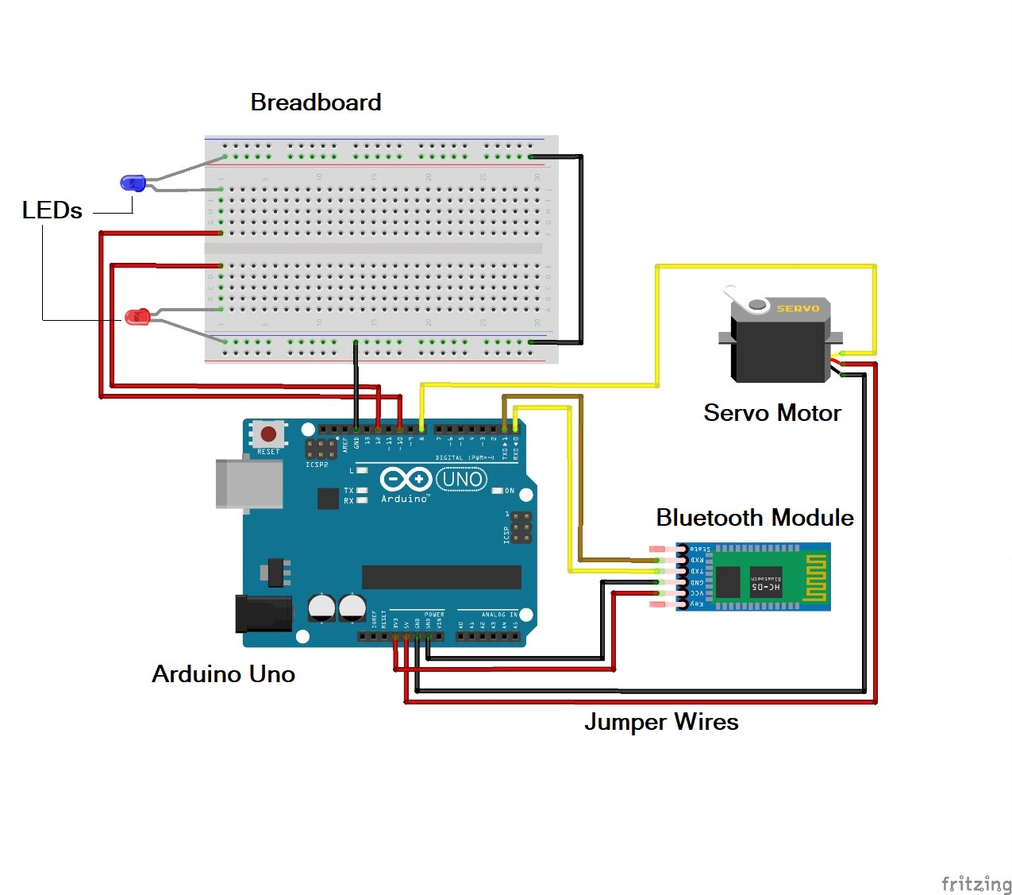
Glance on Work
A picture of the assembled circuit alongside the schematic design

Slide 12
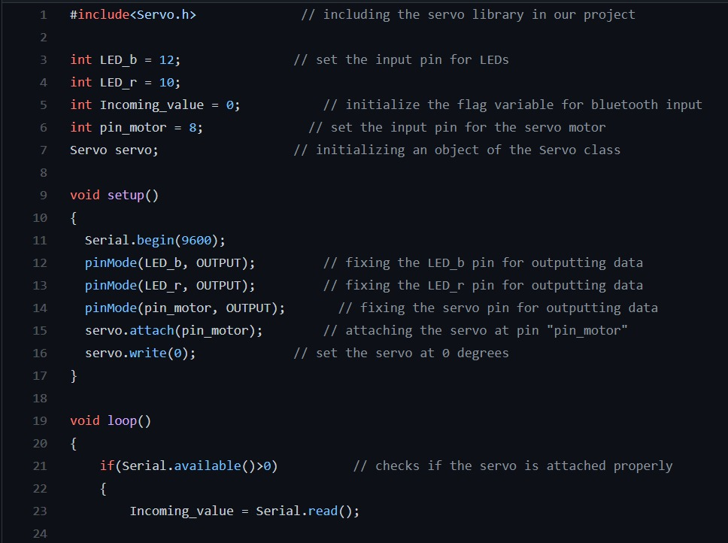
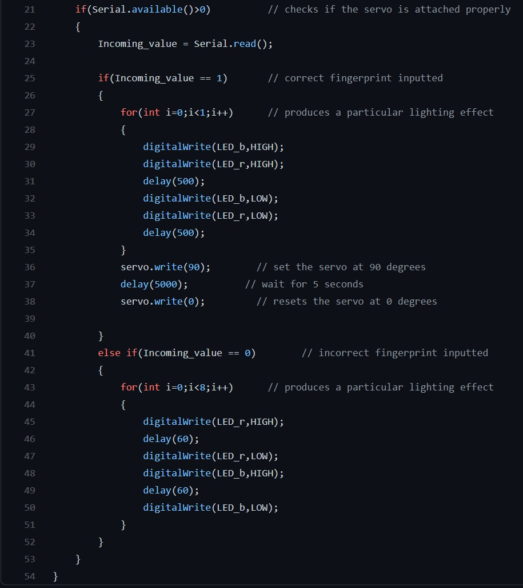
Glance on Arduino Code
A snip of the Arduino code used in our project

Slide 13
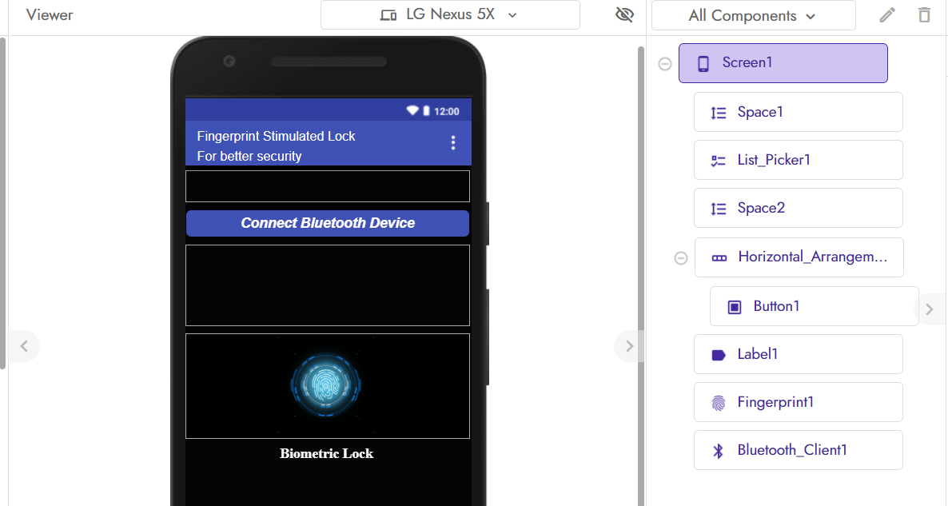
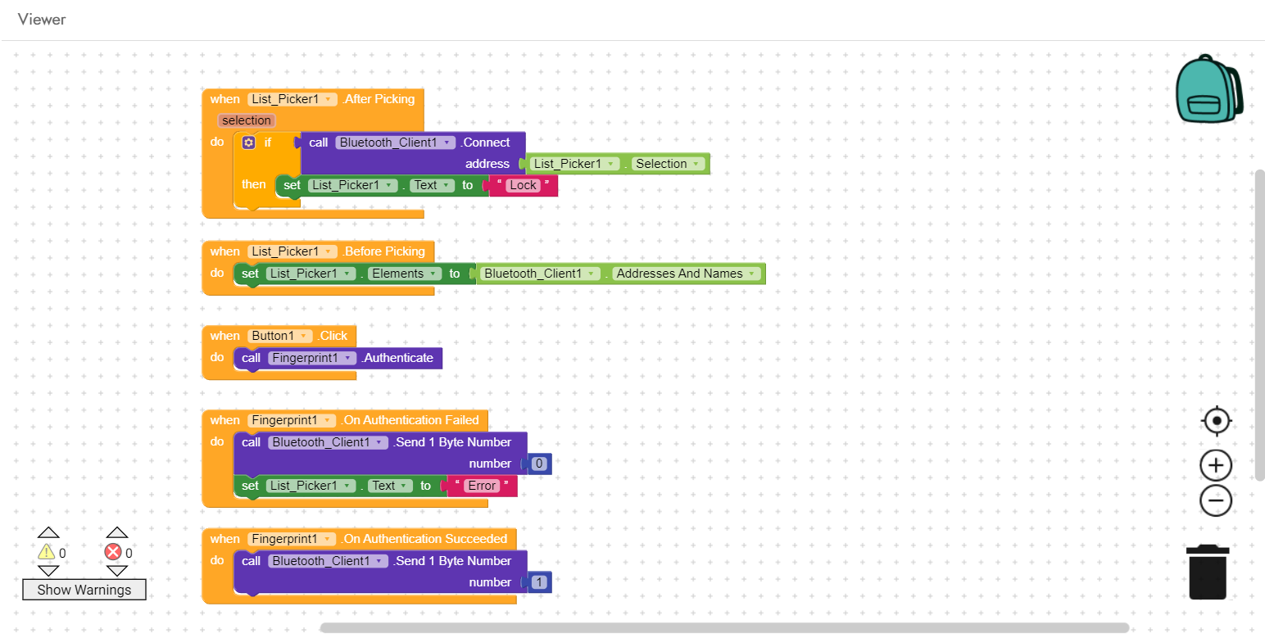
Glance on App Work
A snip of the layout of the screen and the code, created on KODULAR CREATER website

Slide 14

ISSUE FACED
The first Arduino UNO that we purchased turned out to be faulty, so we had to buy a new one.
During testing, the Servo motor was unable to move the latch, so we replaced it with a lighter variant.

Slide 15

Conclusion
The work has been completed on time
Thank You ☺

